Slide 1
Decoupled and Fast decoupled

Slide 2
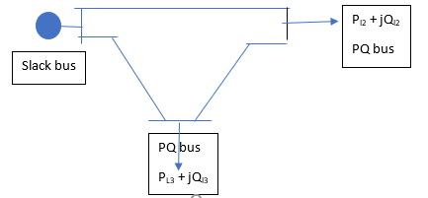
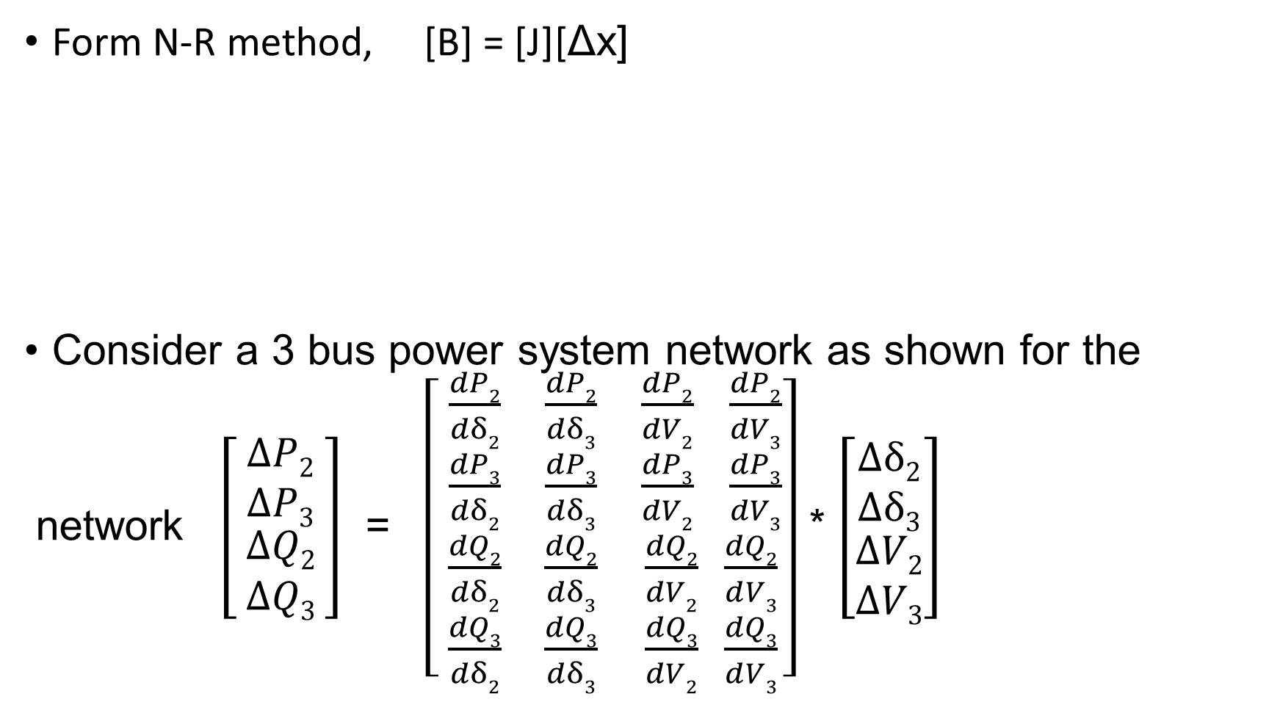
Decoupled method
Form N-R method, [B] = [J][Δx]
Consider a 3 bus power system network as shown for the
network $\left[\begin{matrix}ΔP2 \\ ΔP3 \\ \begin{aligned}ΔQ2 \\ ΔQ3\end{aligned}\end{matrix}\right]$ = $\left[ \begin{matrix}\frac{dP2}{dδ2} & \frac{dP2}{dδ3} & \frac{dP2}{dV2} \frac{dP2}{dV3} \\ \begin{aligned}\frac{dP3}{dδ2} \\ \frac{dQ2}{dδ2}\end{aligned} & \begin{aligned}\frac{dP3}{dδ3} \\ \frac{dQ2}{dδ3}\end{aligned} & \begin{aligned}\frac{dP3}{dV2} \frac{dP3}{dV3} \\ \frac{dQ2}{dV2} \frac{dQ2}{dV3}\end{aligned} \\ \frac{dQ3}{dδ2} & \frac{dQ3}{dδ3} & \frac{dQ3}{dV2} \frac{dQ3}{dV3}\end{matrix}\right]$ * $\left[\begin{matrix}Δδ2 \\ Δδ3 \\ \begin{aligned}ΔV2 \\ ΔV3\end{aligned}\end{matrix}\right]$

Slide 3
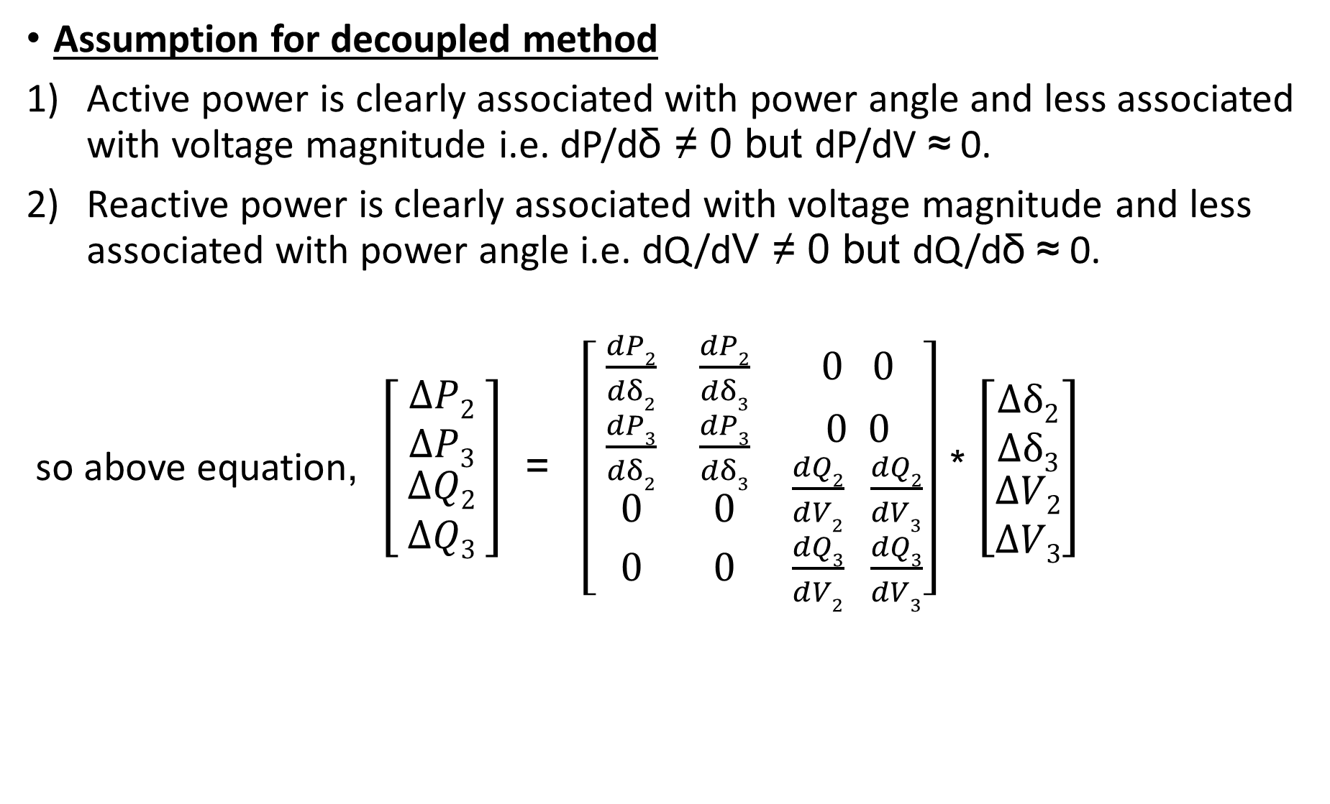
Assumption for decoupled method
Active power is clearly associated with power angle and less associated with voltage magnitude i.e. dP/dδ ≠ 0 but dP/dV ≈ 0.
Reactive power is clearly associated with voltage magnitude and less associated with power angle i.e. dQ/dV ≠ 0 but dQ/dδ ≈ 0.
so above equation, $\left[\begin{matrix}ΔP2 \\ ΔP3 \\ \begin{aligned}ΔQ2 \\ ΔQ3\end{aligned}\end{matrix}\right]$ = $\left[ \begin{matrix}\frac{dP2}{dδ2} & \frac{dP2}{dδ3} & 0 0 \\ \begin{aligned}\frac{dP3}{dδ2} \\ 0\end{aligned} & \begin{aligned}\frac{dP3}{dδ3} \\ 0\end{aligned} & \begin{aligned}0 0 \\ \frac{dQ2}{dV2} \frac{dQ2}{dV3}\end{aligned} \\ 0 & 0 & \frac{dQ3}{dV2} \frac{dQ3}{dV3}\end{matrix}\right]$ * $\left[\begin{matrix}Δδ2 \\ Δδ3 \\ \begin{aligned}ΔV2 \\ ΔV3\end{aligned}\end{matrix}\right]$

Slide 4
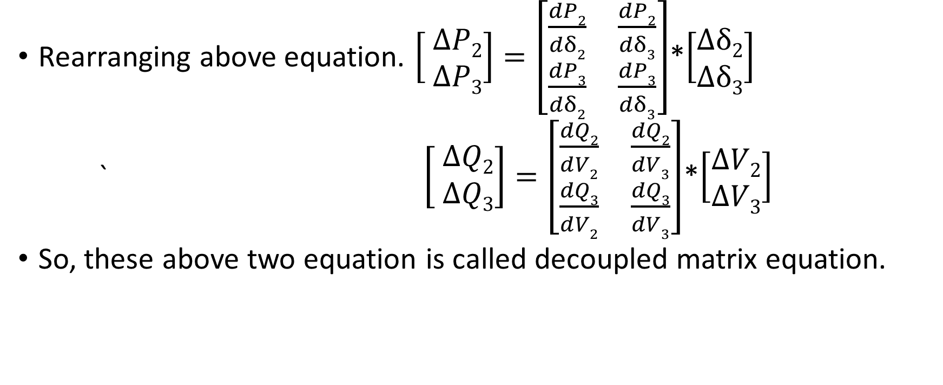
Rearranging above equation. $\left[ \begin{matrix}ΔP2 \\ ΔP3\end{matrix}\right]=\left[\begin{matrix}\frac{dP2}{dδ2} & \frac{dP2}{dδ3} \\ \frac{dP3}{dδ2} & \frac{dP3}{dδ3}\end{matrix}\right]$*$\left[\begin{matrix}Δδ2 \\ Δδ3\end{matrix}\right]$
` $\left[ \begin{matrix}ΔQ2 \\ ΔQ3\end{matrix}\right]=\left[\begin{matrix}\frac{dQ2}{dV2} & \frac{dQ2}{dV3} \\ \frac{dQ3}{dV2} & \frac{dQ3}{dV3}\end{matrix}\right]$*$\left[\begin{matrix}ΔV2 \\ ΔV3\end{matrix}\right]$
So, these above two equation is called decoupled matrix equation.

Slide 5
Fast decoupled method
Additional assumption to decoupled method
Difference between phase angle of two buses is very small. i.e. if i and j are two buses then δ_{i} – δ_{j} = 0.
so cos(δ_{i} – δ_{j} )=1 and sin(δ_{i} – δ_{j} )≈ 0
2) Voltage magnitude on each bus is nearly equal to 1 p.u.
3) A transmission has higher reactance compared to reactance of line. So R ≈ 0.
4) Reactive power at normal case Q_{k} is much smaller than reactive power when all the lines connected to bus k are short circuited ( (V_{k})²B_{kk} ) where B_{kk} is self susceptance of bus k
i.e Q_{k} << V_{k}²B_{kk} so Q_{k} is neglected in some cases.

Slide 6
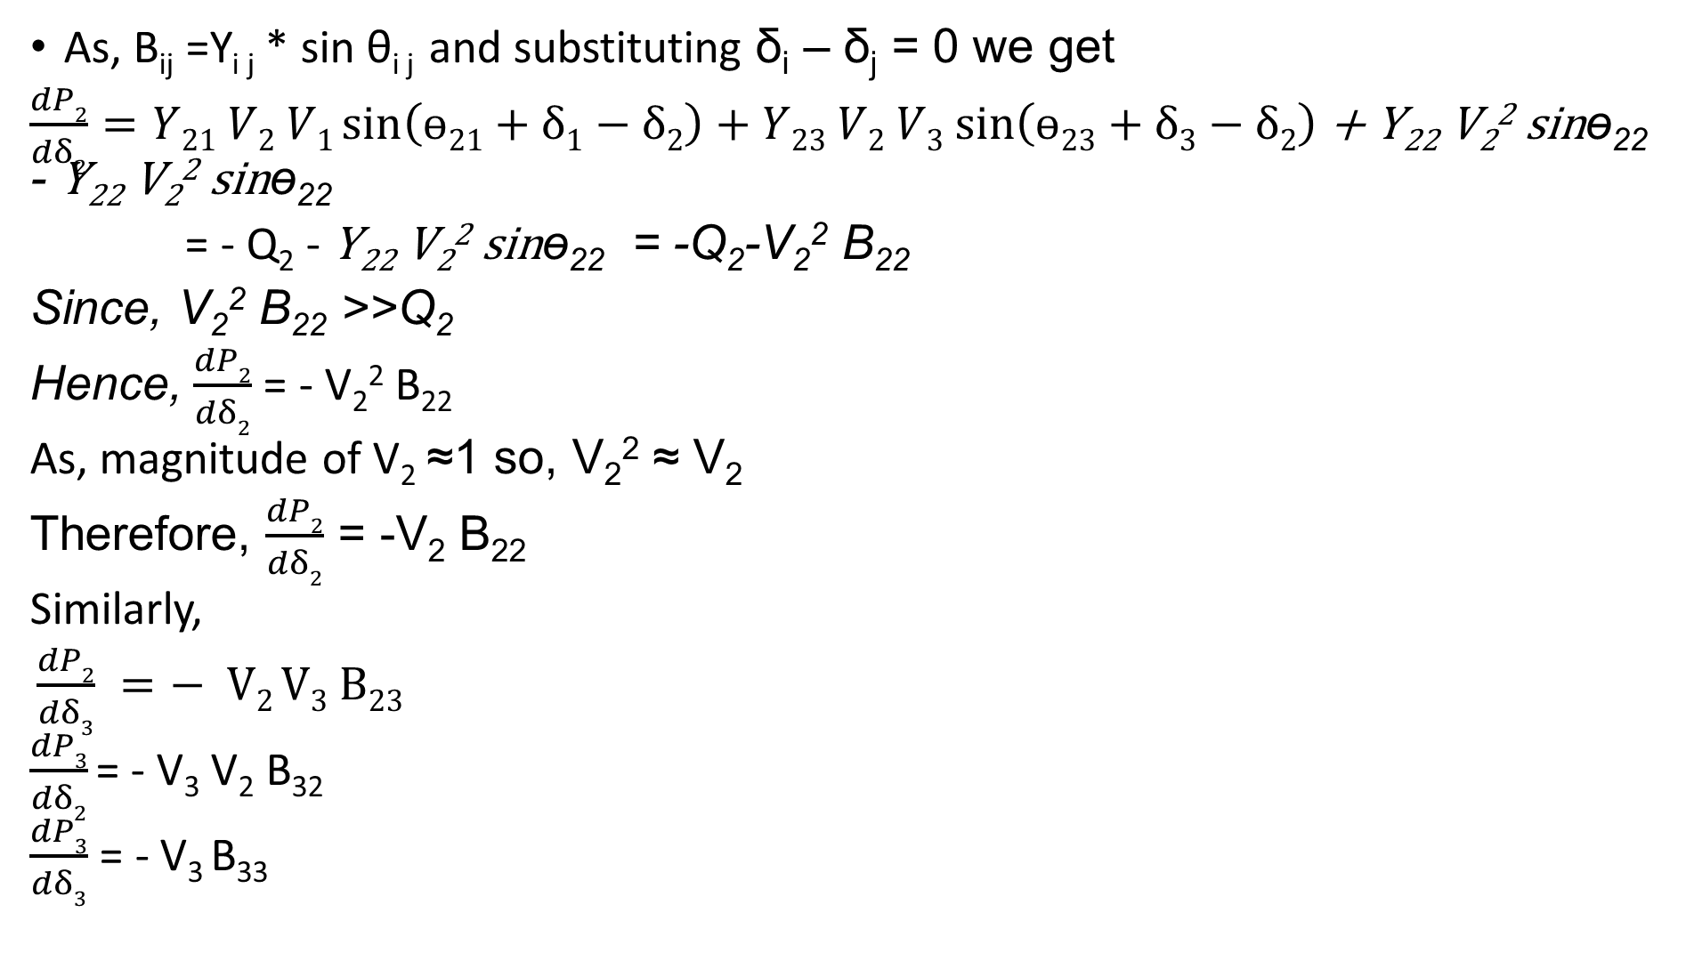
As, B_{ij} =Y_{i j} * sin θ_{i j} and substituting δ_{i} – δ_{j} = 0 we get
$\frac{dP2}{dδ2}=Y21 V2 V1\sin\left(ɵ21+δ1−δ2\right)+Y23 V2 V3 sin⁡\left(ɵ23+δ3−δ2\right)$ + Y₂₂ V₂² sinɵ₂₂ - Y₂₂ V₂² sinɵ₂₂
= - Q₂ - Y₂₂ V₂² sinɵ₂₂ = -Q₂-V₂² B₂₂
Since, V₂² B₂₂ >>Q₂
Hence, $\frac{dP2}{dδ2}$ = - V₂² B₂₂
As, magnitude of V₂ ≈1 so, V₂² ≈ V₂
Therefore, $\frac{dP2}{dδ2}$ = -V₂ B₂₂
Similarly,
$\frac{dP2}{dδ3} =− V2 V3 B23$
$\frac{dP3}{dδ2}$ = - V₃ V₂ B₃₂
$\frac{dP3}{dδ3}$ = - V₃ B₃₃

Slide 7
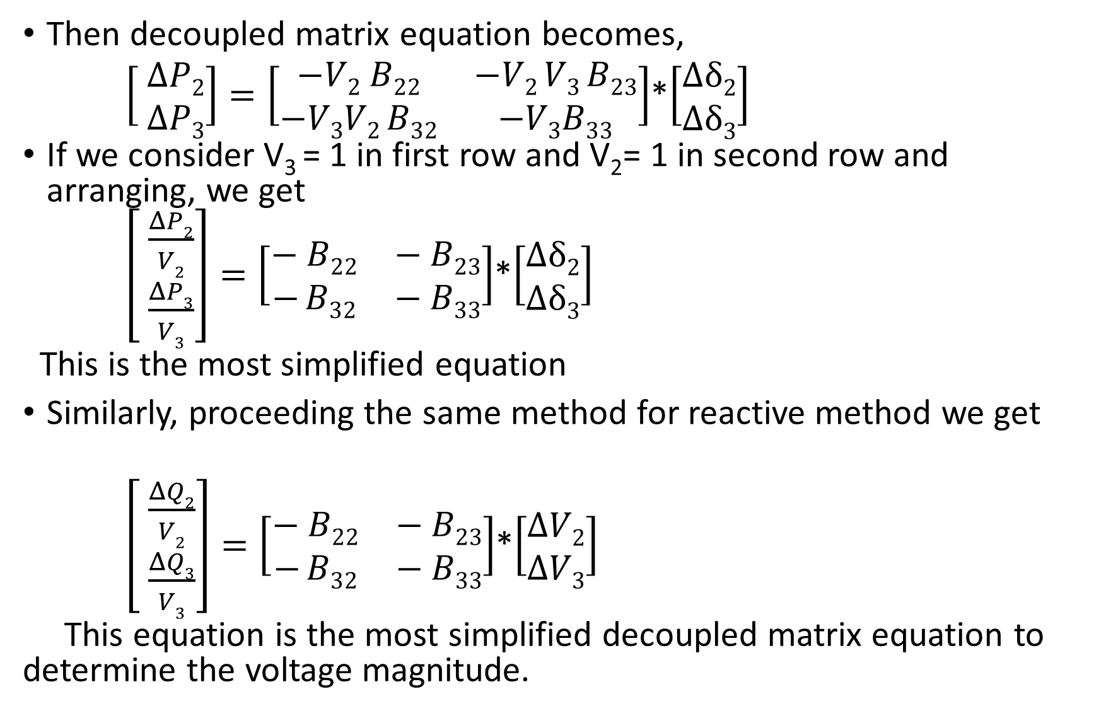
Then decoupled matrix equation becomes,
$\left[ \begin{matrix}ΔP2 \\ ΔP3\end{matrix}\right]=\left[\begin{matrix}−V2 B22 & −V2 V3 B23 \\ −V3V2 B32 & −V3B33\end{matrix}\right]$*$\left[\begin{matrix}Δδ2 \\ Δδ3\end{matrix}\right]$
If we consider V₃ = 1 in first row and V₂= 1 in second row and arranging, we get
$\left[ \begin{matrix}\frac{ΔP2}{V2} \\ \frac{ΔP3}{V3}\end{matrix}\right]=\left[\begin{matrix}− B22 & − B23 \\ − B32 & − B33\end{matrix}\right]$*$\left[\begin{matrix}Δδ2 \\ Δδ3\end{matrix}\right]$
This is the most simplified equation
Similarly, proceeding the same method for reactive method we get
$\left[ \begin{matrix}\frac{ΔQ2}{V2} \\ \frac{ΔQ3}{V3}\end{matrix}\right]=\left[\begin{matrix}− B22 & − B23 \\ − B32 & − B33\end{matrix}\right]$*$\left[\begin{matrix}ΔV2 \\ ΔV3\end{matrix}\right]$
This equation is the most simplified decoupled matrix equation to determine the voltage magnitude.

Slide 8
Q. Write down the algorithm and flowchart for fast decoupled load flow analysis.
.

Slide 9
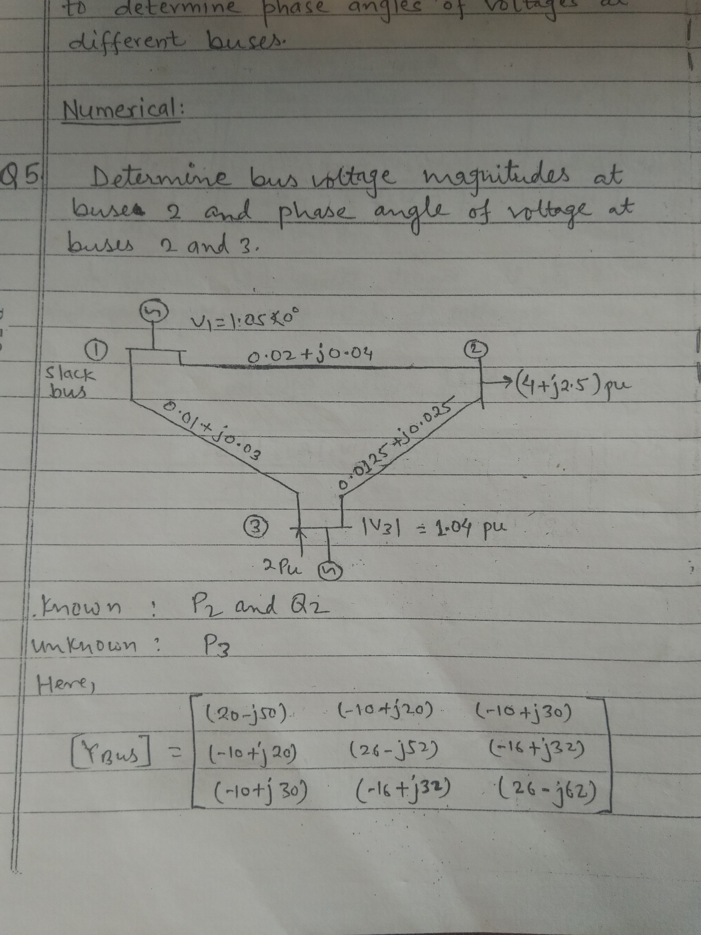
Q.

Slide 10
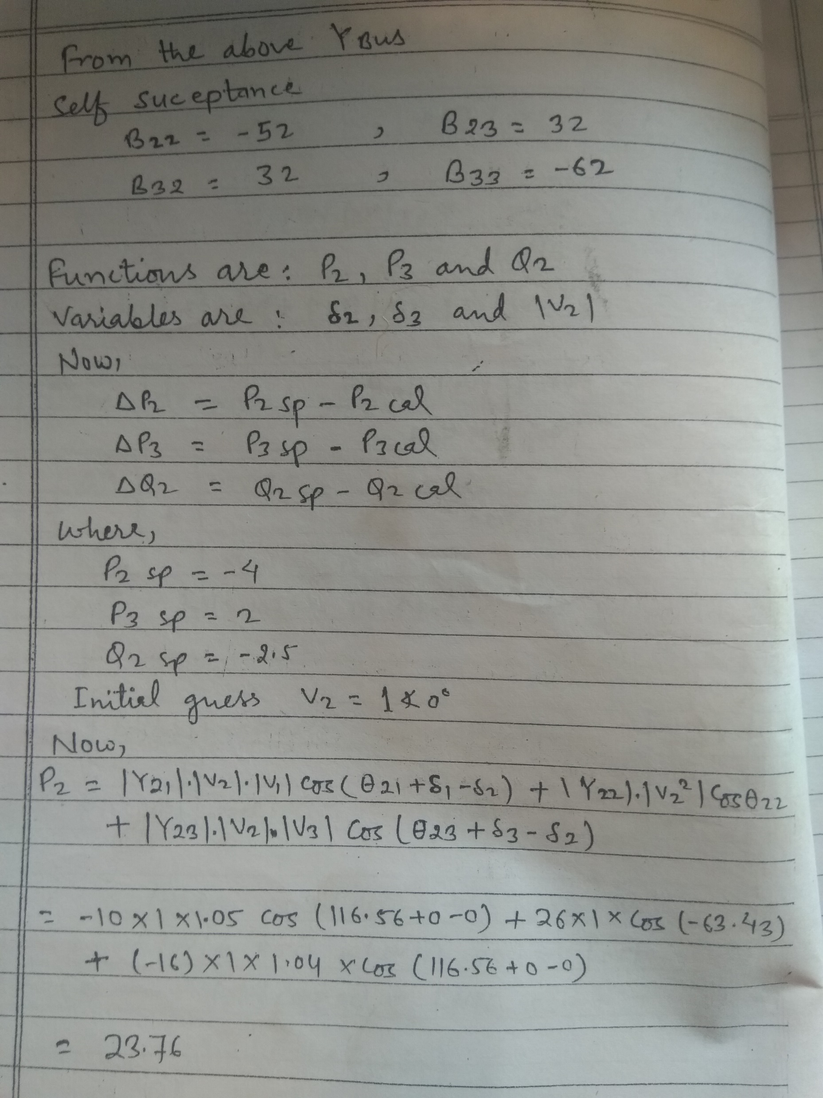

Slide 11
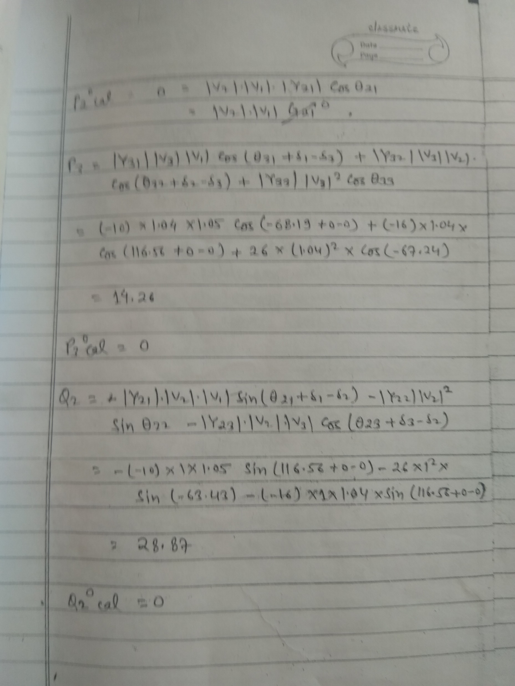

Slide 12
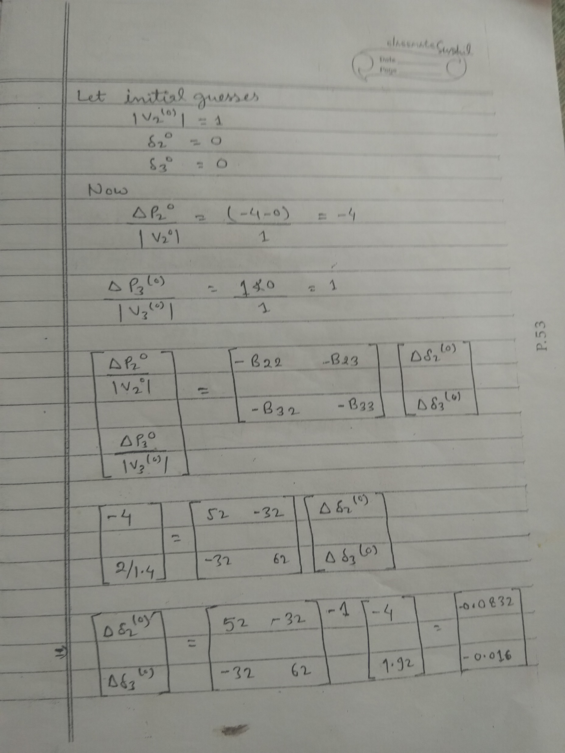

Slide 13
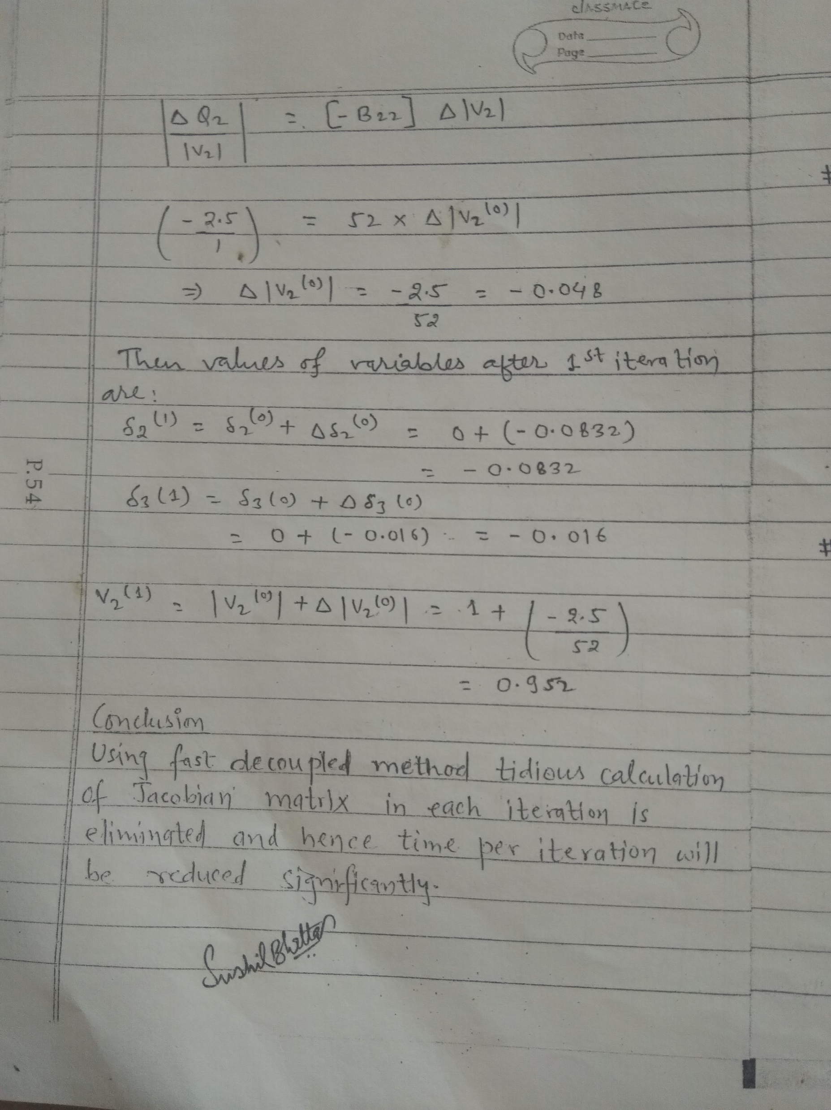

Slide 14
FDPF Three Bus Example
Use the FDPF to solve the following three bus system

Slide 17
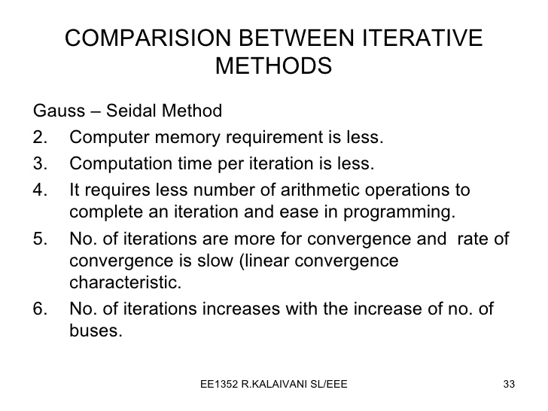

Slide 18
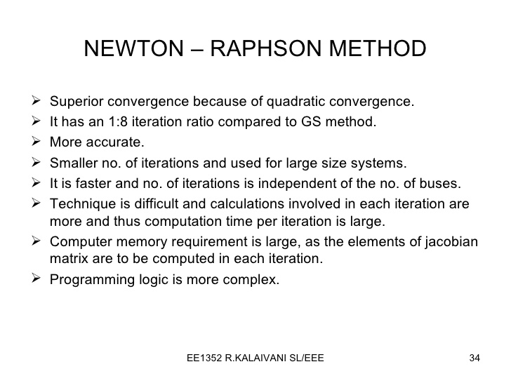

Slide 19
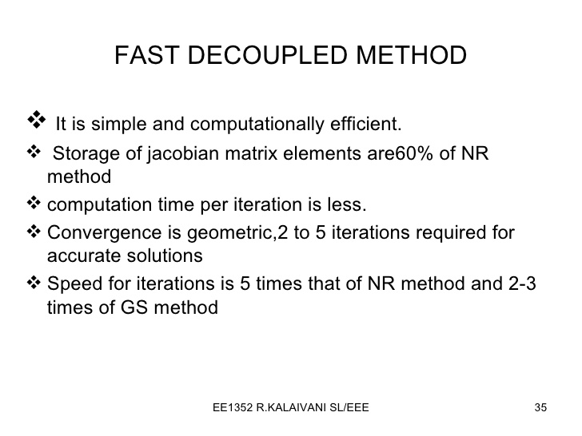

Slide 20
Q. Write down comparison chart between gauss-siedal, newton Raphson and fast decoupled method for load flow analysis.

